Slide 1
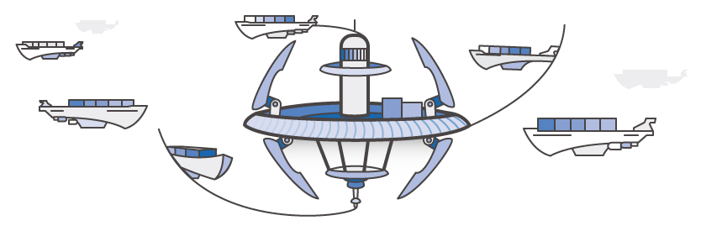
ECS
-Presented by
Nishant Kumar & Neha Agarwal

Slide 2
ECS BUILDING BLOCKS
Cluster
Task definition
Services

Slide 3
Task Placement
Strategies
Constraints
Attributes

Slide 4
Task Placement: When we launch/terminate a task that uses the EC2 launch type, Amazon ECS must determine where to place/terminate the task based on the requirements specified in the task definition, such as CPU and memory. Similarly, in the case of scaling down.
Task placement strategy: is an algorithm for selecting instances for task placement or tasks for termination.

Slide 5
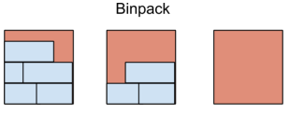
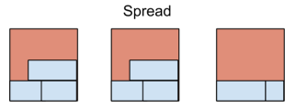
Task Placement Strategies:
Bin pack
Spread
Random

Slide 6
Binpack:
"placementStrategy": [ { "field": "memory", "type": "binpack" } ]
Random:
"placementStrategy": [ { "type": "random" } ]
Spread:
"placementStrategy": [ { "field": "instanceId", "type": "spread" } ]
Examples:

Slide 7
Task Placement Constraints:
A task placement constraint is a rule that is considered during task placement.
distinctInstance
memberOfPlace

Slide 8
Task Placement Attributes:
Attributes are nothing but the metadata that we can add to
any container instance.
They can be built in or custom.
Built-in attributes are:
1. ecs.ami-id
2. ecs.availability-zone
3. ecs.instance-type
4. ecs.os-type

Slide 9
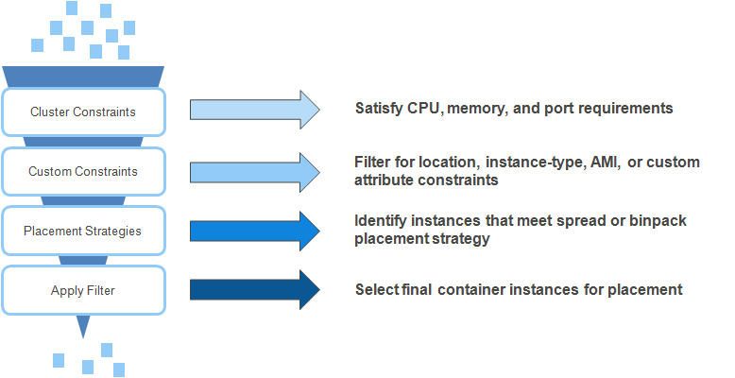
Task Placement Process

Slide 10


